Slide 1
Teen Programs That Work

Slide 2
Fall of 2011
Writing Club
Junior High Book Club
Summer Reading Program
Annual Tie Dye Party
Notes:
Begin by explaining the history of Murray Library’s teen programming

Slide 3
Fall of 2012
Added book club for high school students
Added weekly after-school gaming hour

Slide 4
Fall of 2013
Added daily after-school programming
Added Teen Advisory Group and activity planning group
Planned and implemented 3 lock-ins

Slide 5
Goals of Teen Programming
Notes:
Get teens inside the library
Foster a sense of ownership/positive relationship with the library
Provide a safe place for creative expression without the pressure of earning a grade
Create opportunities for teens to “geek out” or explore their intellectual interests
Spark the love of reading

Slide 6
Quantity Vs. Quality
Notes:
While attendance is important and looks good on paper, it is not the only factor when considering the success of a program
Influencing the life of a small number of teens is better than giving up the fight
Teen programs are often sparsely attended. Similarly, teens check out fewer items and read fewer books than any other age group. This should not be an argument to minimize teen programming, but the reason why it is important.

Slide 7
After-School Programming
The Art of Hanging Out
Notes:
Many of the programs we do after school you could pull of as a drop-in, particularly the gaming aspect. This are simply a series of ideas that we found actually work.

Slide 8
Our space
Notes:
3 Big Screen TV’s, 2 Wii’s, and 1 Xbox 360, 4 tables, 50 chairs

Slide 9
The Schedule
Monday: Coloring
Tuesday: Alternating Nail Club, Lego Club
Wednesday: Just Games
Thursday: Crafts
Friday: Wild Card Day
Notes:
This schedule was different at the beginning of the year. Monday was board games and Wednesday was video games. But we soon learned that the kids wanted to get out both types of games every day.
We also learned that having multiple options gives the program more of a “hanging out” feel. Teens can choose what they want to do, and move around to different activities. This is optimal for a multitasking generation. This also makes teens who don’t want to participate in any activities, but want to come to the program for purely social reasons, feel comfortable sitting at the side lines with their cell phones. Our participation increased dramatically when we figured this out.
The primary activity is there for the kids who want variety. We do the same schedule every week so the kids know what to anticipate

Slide 10
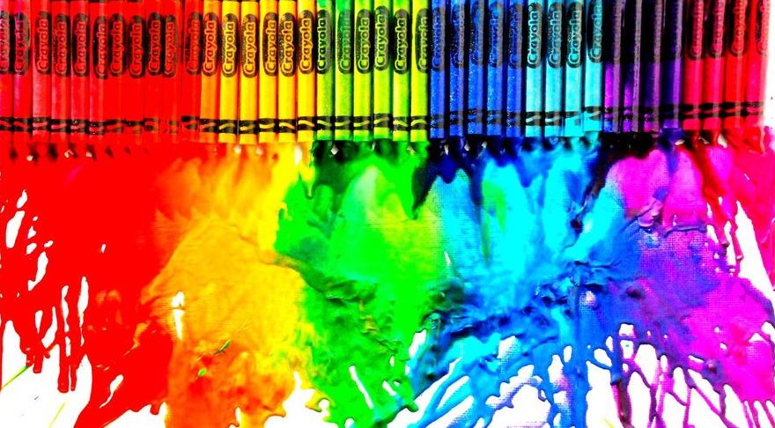
Monday: Coloring
Print out coloring sheets from Google images
Ask teens what they want
Notes:
The idea to color every week was teen driven and the coloring pages themselves are teen driven.
Use markers instead of crayons

Slide 11
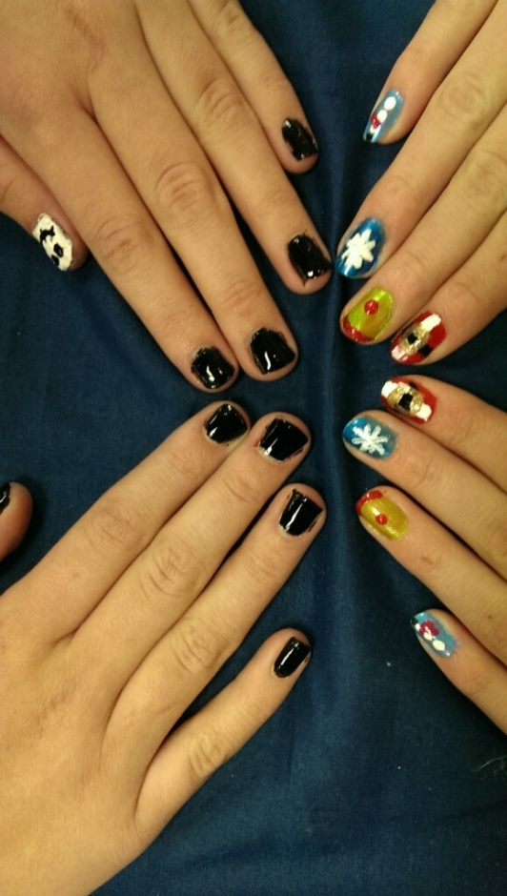
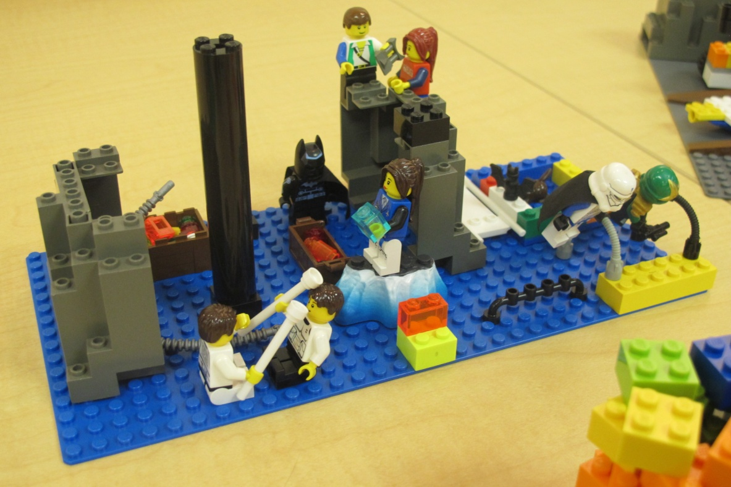
Tuesday: Nail Club/Lego Club
We use Legos from the children’s department
Cheap nail polish– black, blue, yellow, seasonal

Slide 12
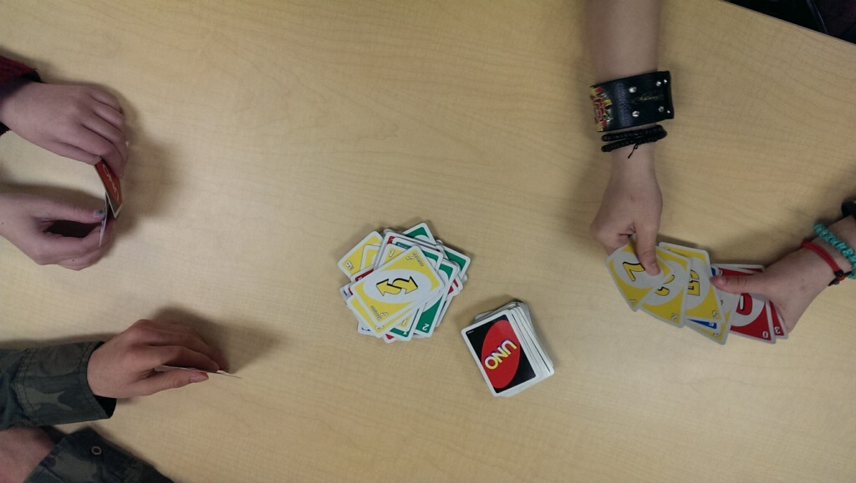
Wednesday: Games
You can start your own gaming with donations and a grant from Walmart
Notes:
Play with the kids- our kids said this element was their favorite part of teen hour
Wii’s are okay to buy used, but get the Xbox 360 new

Slide 13
Thursday: Crafts

Slide 14
6 Dream Crafts for teens
For a $10-$20 budget for a group of 10-25

Slide 15
The Soctopus $11
http://bloodybunny.blogspot.com/2012/11/socktopus-tutorial.html

Slide 16
Socktopus Hacks
Kmart often has clearance socks for under $1
Buy felt squares for the eyes
Cut out eyes beforehand or provide eye templates for teens who have trouble with cutting perfect circles

Slide 17
Marshmallow Guns $25
http://ohamanda.com/2011/10/06/how-to-make-a-mini-marshmallow-shooter-gun-from-pvc-pipe/

Slide 18
Marshmallow Gun Hacks
Do this craft during the warmer months, and host a marshmallow gun fight outside
The simpler/smaller the marshmallow gun pattern you use, the cheaper this craft is
Sort out the pieces you need for each gun then put them in individual plastic bags
Trace out the basic pattern of the gun on poster board for demonstration purposes
Use colored duct tape or sharpies to decorate the guns

Slide 19
Easter egg tea cups $9
http://www.creativityinprogress.com/plastic-easter-egg-tea-cups/

Slide 20
Easter egg tea cup hacks
Use hot glue instead of tacky glue
Offer as many decorating options as possible (sharpies, tiny jewels, buttons, puff balls)
Buy eggs the day after Easter for a discount
Use hot glue to cover up air holes to make the tea cup functional

Slide 21
Slenderman $7

Slide 22
Slenderman hacks
Cut his suit, head, hands, shirt and tie free-form out of felt
Attach his back to a clothespin with hot glue
Use the clothespin to hold his tentacles in place

Slide 23
Cd shard ornaments $9.50
http://www.cremedelacraft.com/2012/11/DIYOrnaments.html

Slide 24
CD shard ornaments hacks
Buy clear ornaments at Michael’s
Use hot glue instead of tacky glue
Cut the CD shards before teens arrive

Slide 25
Necktie Snakes $9
http://thecraftymummy.com/2012/08/kids-craft-necktie-snakes/

Slide 26
Necktie snake hacks
Ask for necktie donations from family and friends
Use a chopstick to stuff the ties with batting
Stuff half of the necktie from one end, and then the rest from the other

Slide 27
4 Crafts for Under $5

Slide 28
Photos with books $0

Slide 29
Puzzle Piece Creatures $2
http://larajla.com/grab-n-go-aliens/
Notes:
Ask people to donate old puzzles that are missing pieces
See if your children’s department has any extra googly eyes

Slide 30
Bottle caps $4
Snowmen:
http://shewhomakes.blogspot.com/2011/12/bottle-cap-snowman.html
Magnets:
http://smilemonsters.blogspot.com/2008/10/how-i-make-bottle-cap-pendants.html
Notes:
Buy bottlecaps at a brewing supply store for 78 cents

Slide 31
Mustaches, Monocles, and such $2
http://www.makeandtakes.com/5-easy-ways-to-make-a-mustache
Notes:
Remember to cut off sharp edges of skewers before craft
Ask the kids to get creative– one of our kids did vampire teeth, another did a bowtie

Slide 32
Friday: wild card
Tournaments, duct tape crafts, read-a-thons
Notes:
Started out as a film day, but this was changed after we decided that the film screenings weren’t working.
Smash brothers tournament

Slide 33
Teen advisory group

Slide 34
Advertise
Visit all of the honors and AP English classes at the high school
Tell the kids who are already coming to your programs about it
Make sure kids know there will be food
Notes:
Talk with the teachers ahead of time so they can back you up
Leave Flyers
Adverise your TAG as a way to help them get scholarships
We did pizza

Slide 35
Keep them excited
Let them take the reins
Hold an election for a presidency
Give them responsibility
Be flexible
Notes:
Let it be their group, not yours.
A presidency allows someone else to run the group, which makes it more teen driven.
It can be a little stressful to rely on teens because they might not follow through. But it’s worth it. If they know you’re counting on them, they’ll follow through most of them time.
If something you wanted your TAG to do doesn’t go anywhere and there is no renewed interest, let it go. Listen to their disinterest as well as you listen to their ideas.

Slide 36
Offer guidance
Bring ideas to every meeting
When you tell them no, tell them why
Honest praise goes farther than frequent praise
Give them credit when they do something fabulous
Notes:
It’s okay if your TAG uses your ideas, as long as they decide your ideas are cool
Teens can tell when you’re being fake.

Slide 37
Lock-Ins

Slide 38
Lock-in hacks
Let your Teen Advisory Group advertise and plan the lock-ins
If you skip the craft you’ll greatly reduce the cost of the lock-in and make your event more palatable to older teens
Plan small activities for the first 20 minutes prior to starting the main event - teens are often late
Any activity that involves running and screaming around the library will likely be fun
Requiring registration may make the lock-in easier to plan, but it will lower attendance

Slide 39
Doctor Who?
Bowties are cool and so is the Doctor

Slide 40
Keeping-it-mysterious Advertisement
Notes:
Every Doctor Who fan will recognize a weeping angel when they see one. There’s no need to say “Doctor Who Party!” in big letters. The mystery makes this advertisement an insider’s secret. I watched a lot of teens smile when they saw it.
We cut the bottom part of this advertisement so teens could take the tabs. It allowed them to take something with them as a reminder.

Slide 41
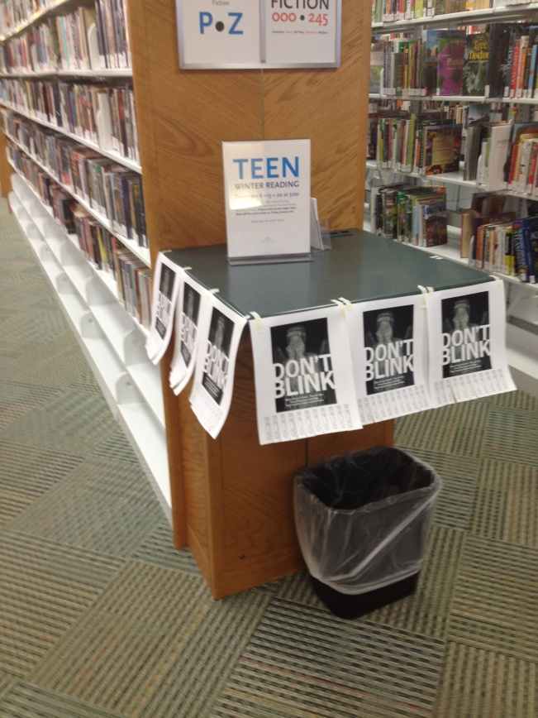
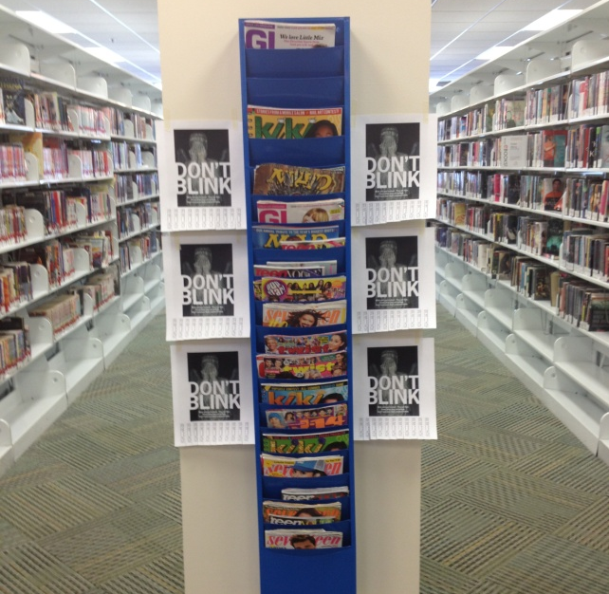
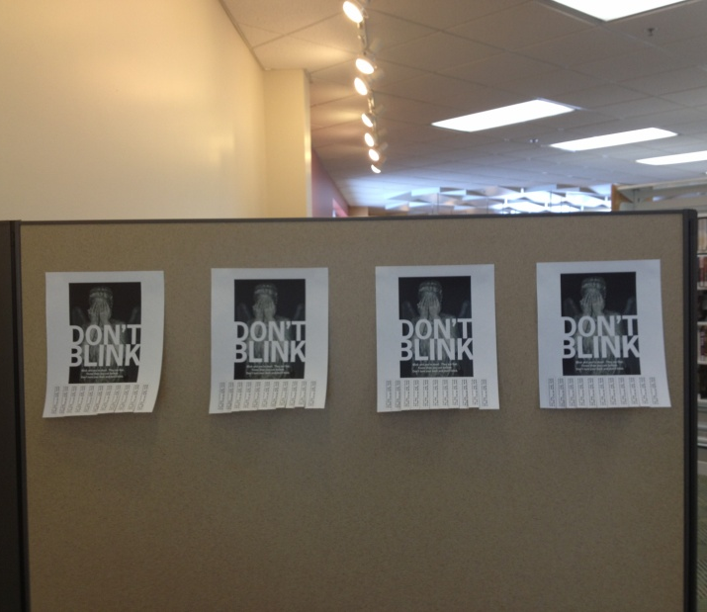
Posting the advertisements
Notes:
This advertising campaign left the teens with the impression that weeping angels were following them everywhere. Some teens loved it and stole the advertisements. One boy confessed that he wanted to hang it on his wall when I caught him. I let him take it. Other teens took the advertisements down because they were creeped out by them. They disappeared en masse.
These advertisements worked. We had over 85 participants at this lock-in.

Slide 42
Decorate

Slide 43
Dress up as a victim of “the silence”
Notes:
Free and fun

Slide 44
First 20 minutes
Bow tie creation contest– the one time you may want to do a craft at a lock-in
When’s the Doctor? By Jorge Santillan (the Where’s Waldo? of Doctor Who)
Doctor Who character match-up
Pin the eyes on the last human

Slide 45
Don’t blink
Red light/green light game where you can only move when the lights are off
When the lights are on players must hold still and cover their eyes
Choose a player to be the Doctor, whoever reaches him first wins

Slide 46
Doctor who villain relay race
Have everyone get into two teams, and then divide into groups of three.
Each member of the group will complete one leg of the relay race
After one group completes the race, the next group on their team can start
The team that finishes first wins

Slide 47
Cybermen
Draw a Cybermen head on a cardboard box, put the cardboard box on the first player’s head and spin them 3 times. Have them walk through an obstacle course while being led only by the sound of their teammates’ voices.

Slide 48
Vashta nerada
You can tell someone has been attacked by the Vashta Nerada if they have two shadows. Therefore the second player will tie each of his feet to the inside foot of the other members of the group. It’s like a 3-legged race, only with three players instead of two.

Slide 49
Dalek
You will need a rolling chair, a whisk and a toilet plunger (I bought these new at the dollar store). The third player will sit in the seat, hold the plunger and whisk in front, and say “Exterminate!” while the other players wheel him/her back to the start of the relay.

Slide 50
Capture the Tardis
Make little tardises (tardi?) out of cardboard and paper
Place each one on opposites sides of your library and play capture the tardis
Call one tardis the “time paradox machine” for a laugh

Slide 51
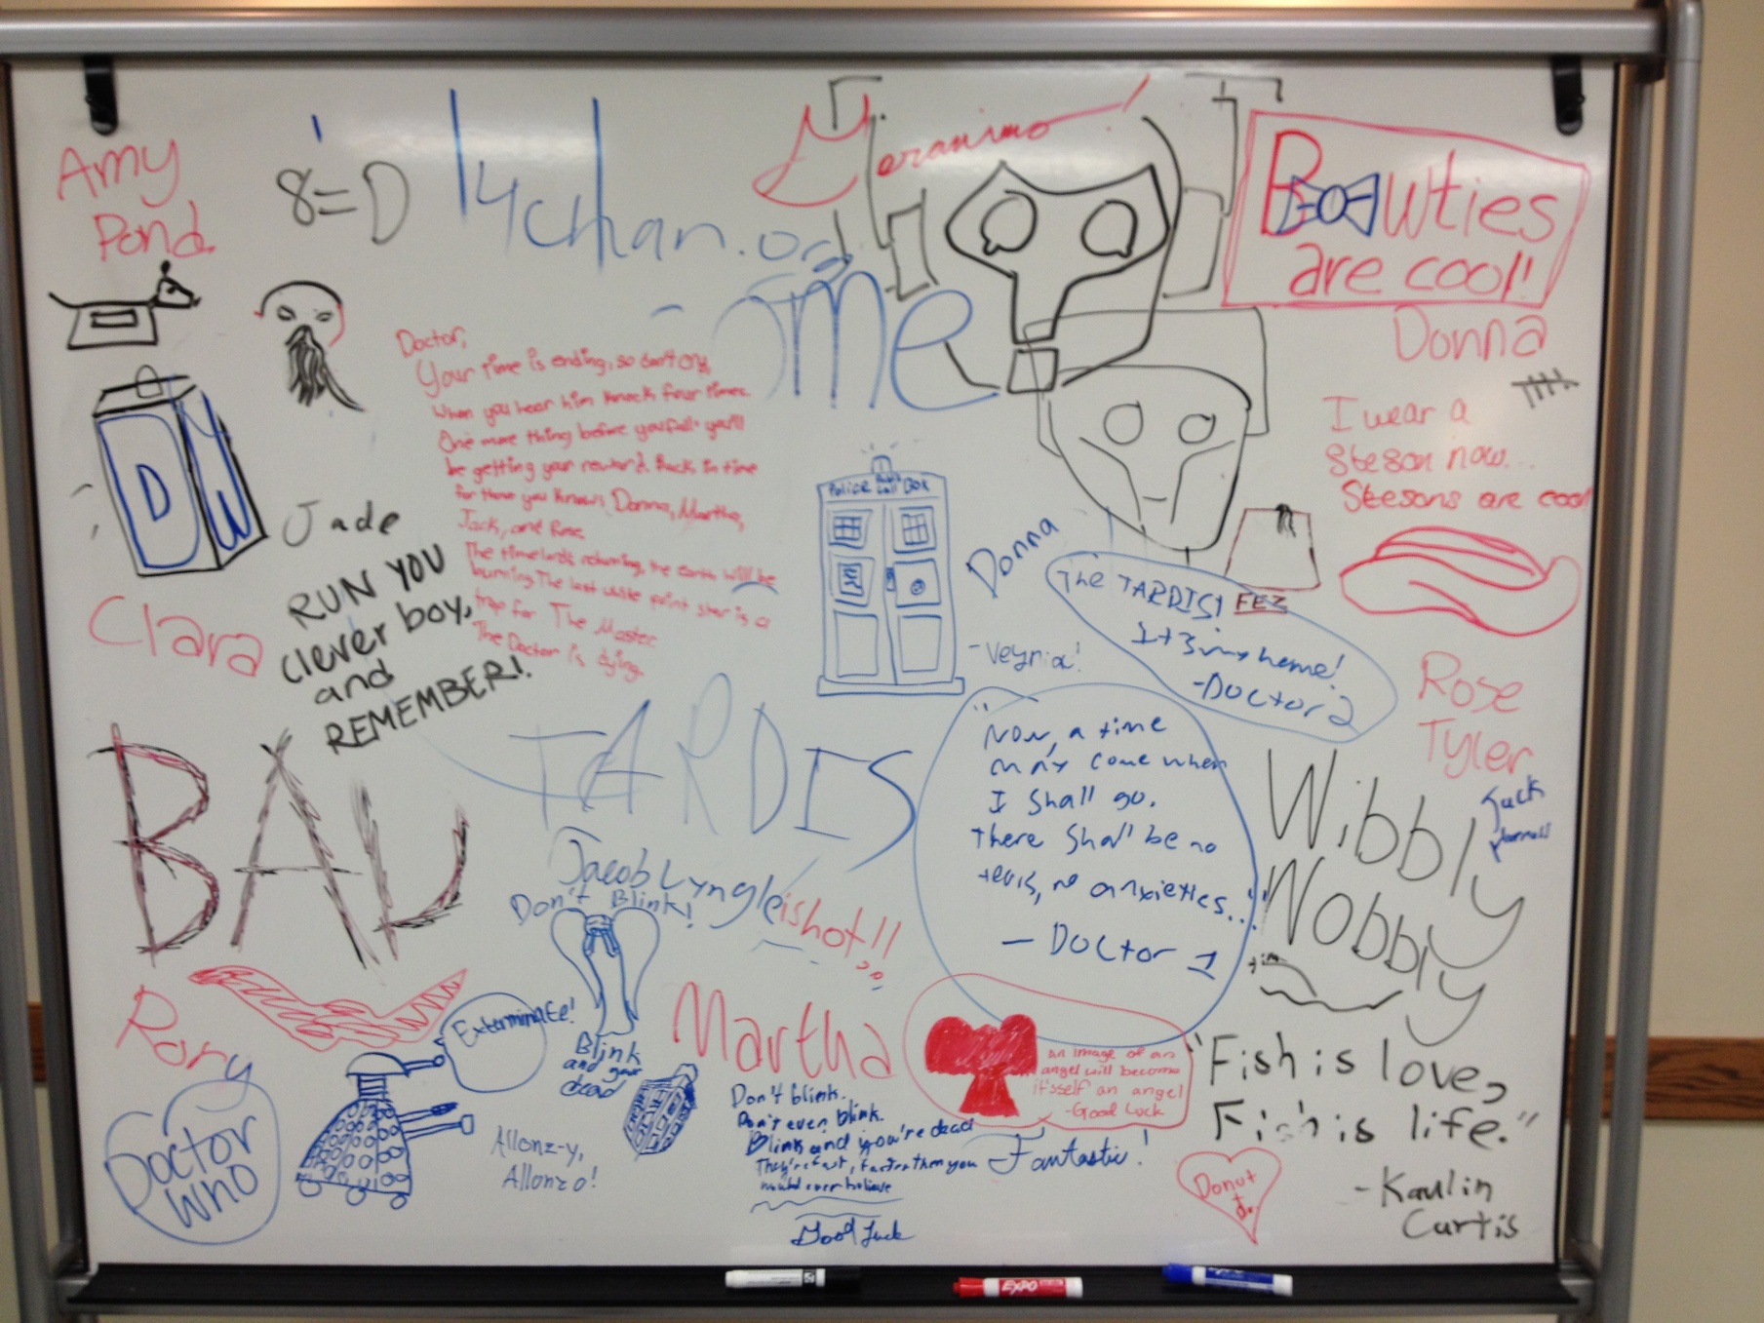

Slide 52
Halloween and Zombies
What teen doesn’t like one or the other?

Slide 53
Keeping-it-creepy Advertisement
Notes:
We did a zombie battle where everyone starts out human except the “original zombie”. The humans each have to complete tasks like hidden puzzles and such before the zombies take over. The zombies took over very quickly. If you do this event, be sure to make things easier for the humans.

Slide 54
Life-sized games
Foosball, Clue, Angry Birds, Candy Crush, Plants vs. Zombies, and Hungry Hungry Hippos.

